Slide 1

Battle Ground Game
Submitted in the partial fulfillment for the award of the degree of
BACHELOR OF ENGINEERING
in
Artificial Intelligence and Machine Learning
Submitted by:
Lokesh Deshwal
18BCS6219
Under the Supervision of:
Prof. Yogiraj Bhale
Department of AIT-CSE
DISCOVER . LEARN . EMPOWER

Slide 2

Outline
Introduction to Project
Problem Formulation
Objectives of the work
Methodology used
Results and Outputs
Conclusion
Future Scope
References

Slide 3


Introduction to Project
Gaming is really a workout for your mind disguised as fun.
Studies have shown that playing video games regularly may increase gray matter in the brain and boost brain connectivity.
Our model/project used the Unity 3D game engine for the Battle-Ground Shooting Game .
It supports the Android functionality

Slide 4

Introduction to Project
This project Battle Ground Game aims at providing the best gaming experience to the user . This project uses android functionality and best ever – uses 3D graphics in the game .This project is very user-friendly as we don’t make use of extra stuff.
This project Battle Ground Game aims at playing online game on the Internet is an increasingly popular kind of mediated entertainment, but it has not yet led to a body of scientific research. In this we will create a multiplayer game where more than 4 people can play within a single room and it will support 25 players to play simultaneously online. In this we are going to use mirror networking to support the multiplayer functionality in the game .It is a android based app where we can move our player with the help of joystick and can attack the enemy with the gun.

Slide 5

Problem Formulation
Performance measures .
Less installation charge .
AI enemy support.
No Overheating while frame drop or vice versa

Slide 6

Objectives
Battle Ground Game aims at providing accurate playback.
Need of the youngsters.
It helps in mental health benefits, better problem solving

Slide 7

Methodology used
The following methodology will be followed to achieve the objectives defined for proposed research work:
Extensive research has shown that the act of play is extremely important in the lives of human beings.
It is thus not surprising that games have a long and continuing history in the development of almost every culture and society.
The advent of computers and technology in general has also been akin to the need for entertainment that every human being seeks. However, a curious dichotomy exists in the nature of electronic games: the vast majority of electronic games are individual in nature whereas the non electronic ones are collective by nature.

Slide 8
We are making use of photons for networking.
The Photon Real-time SDK is the lean and core API to access all Photon Cloud Services.
It is the base for the higher level multiplayer SDKs: PUN, BOLT and QUANTUM.
The communication SDKS - Photon VOICE, VIDEO and CHAT - base on it as well

Slide 9
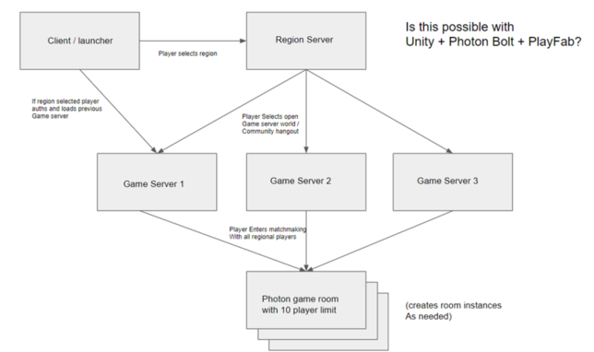
Flowchart

Slide 10

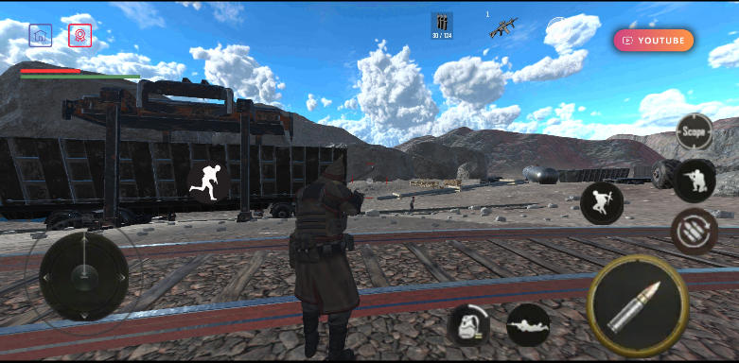
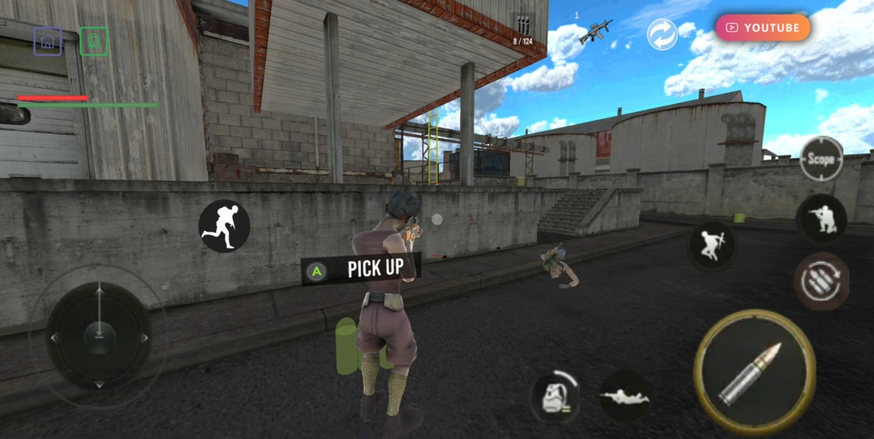
Results and Outputs

Slide 11
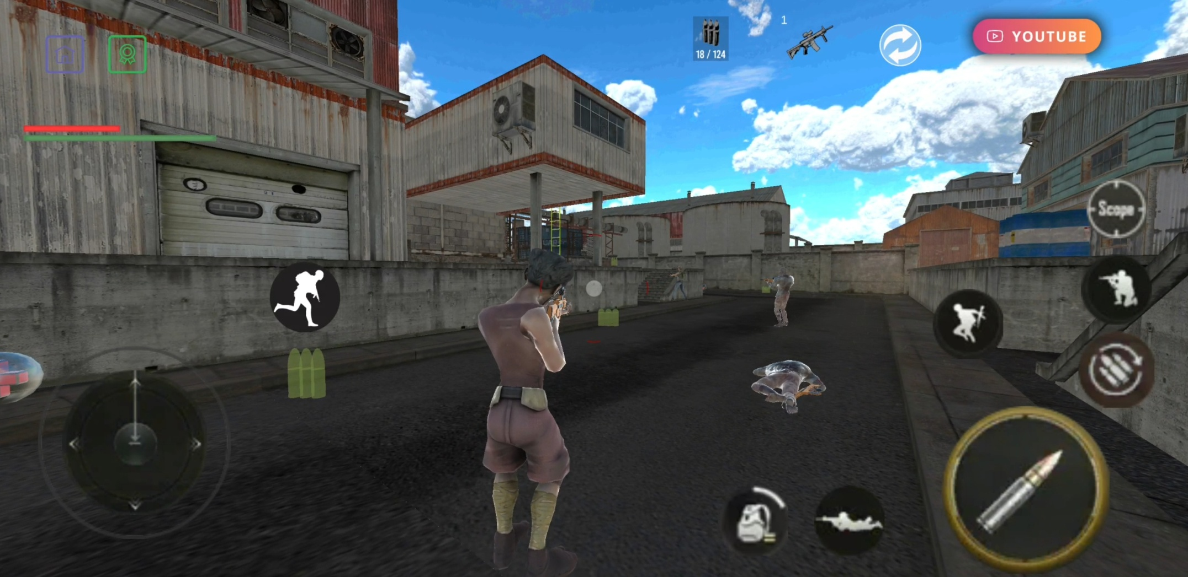

Slide 12

Conclusion
People who know how to make games need to start focusing on the task of making real life better for as many people as possible.
Most of the other sectors stick to only one platform and then move to the another, once they have established their presence on the same. However the ‘Gaming Industry’ has a different story to tell.

Slide 13

Future Scope
It is forecasted that the gaming industry will generate great opportunities for game developers over the next two years.
The gaming industry has grown its presence over various platforms – mobile, console, PC, online gaming and the industry is growing really fast along with the presence on all these platforms.
Pertaining to this, there is a rising demand for professionals in this field, from artists to programmers to designers to audio engineers

Slide 14

References
[1] Griffiths, M.D., Davies, M.N.O., & Chappell, D.(2004b). Demographic factors and playing variables in online computer gaming. Cyber Psychology & Behavior 7:479–487.
[2]. Griffiths, M.D., Davies, M.N.O., & Chappell, D.(2003). Breaking the stereotype: the case of online gaming. Cyber Psychology & Behavior 6:81–91.
[3]. Griffiths, M.D., Davies, M.N.O., & Chappell, D. (2004a).Online computer gaming: a comparison of adolescent and adult gamers. Journal of Adolescence 27:87–96.

